Slide 1
OneCube
Yawen(Frank) Tian
CSC490

Slide 2
Demo

Slide 6
Core Functionalities
View
Colors, Stroke
Touch event
Row rotation
Change of View
Play Back

Slide 7
To Be Implemented
Timer
Logic to check solved
Randomizer
Rotation animation, (3D view)

Slide 8
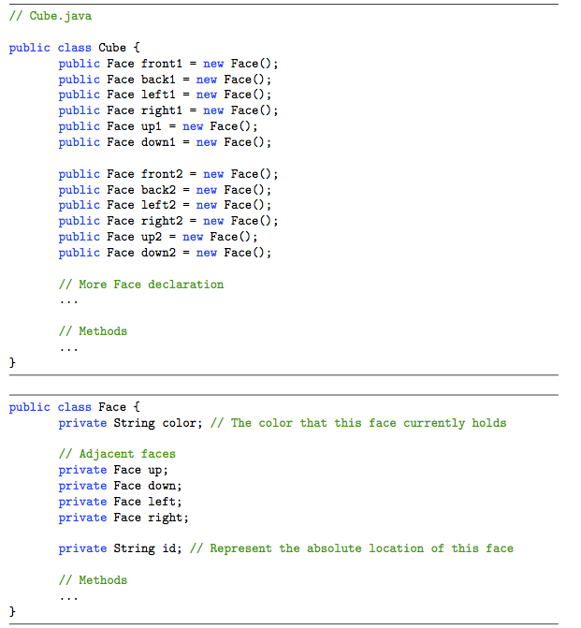
Implementation

Slide 9
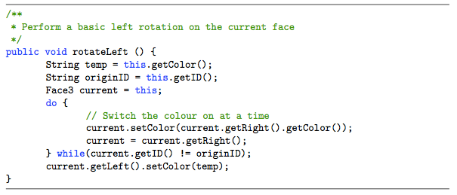
Implementation

Slide 10
Mathematical Discussion

Slide 11
Permutation

Slide 12
Reference
http://franktian.github.io/Rubiks-Cube/
https://play.google.com/store/apps/details?id=com.onecube
yawen.tian@mail.utoronto.ca

